Slide 1

Introducing Functions
Domain, Range & Functions Tables

Slide 2
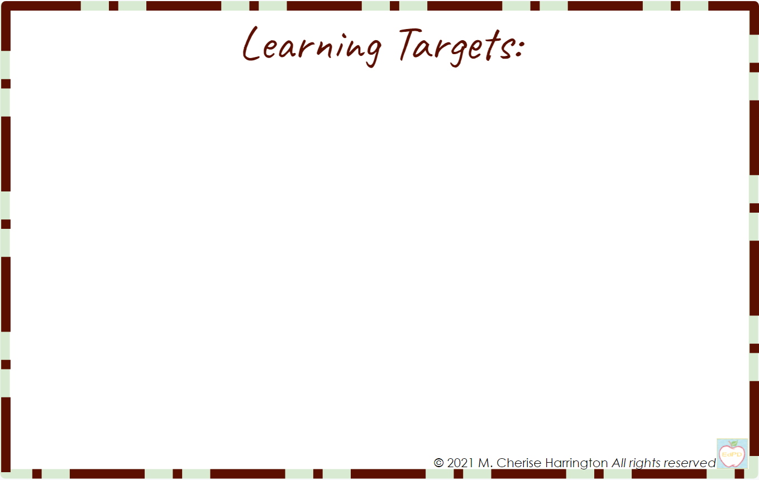
Content Objective: I will be able to define a function as a relation with exactly one input for every output.
Language Objective: I will be able to explain how to tell if a relation is a function in a table, set of coordinates and graph.

Slide 3
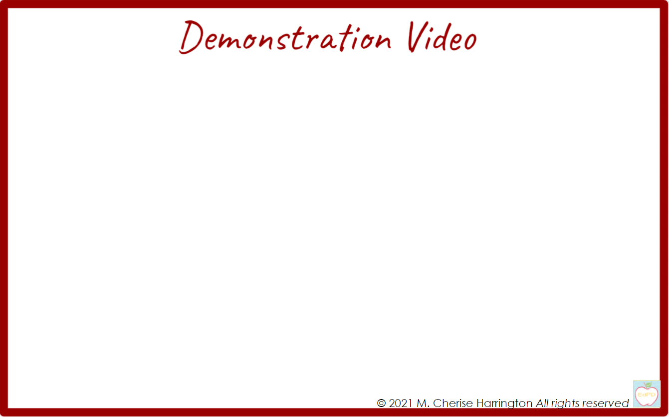
English
Spanish
que es una función
What are Functions
funciones o relaciones: grafica
Relations & Functions
Relations & Functions
funciones o relaciones: coordenadas

Slide 4
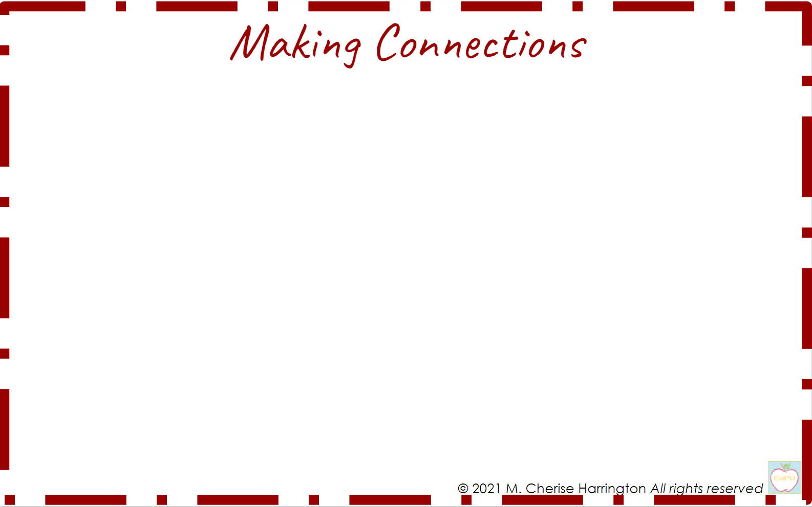
Domain & Range
Equation
y = 3x + 7
 | Definition | Examples
Domain | The “input” in a table or “x” values of an equation or a set of coordinate pairs | {1, 2, 3, 10}
Range | The “output” in a table or “y” values of an equation or a set of coordinate pairs | {10, 13, 16, 37}
Table
Input | Output
x | y
Domain | Range
1
2
3
10
n
Set of Coordinate Pairs (x , y)
{
}
(1 , )
(2 , )
(3 , )
(10 , )

Slide 5
What is a Function
 | Definition | Examples
Function | A relation in which there is exactly 1 input for each output | {0, 5, 3, 2} {1, -1, 1, 4}
Not a Function | All functions are relations, but not all relations are functions | {1, -1, 1, 4} {0, 5, 3, 2}
Relation: Set of Coordinate Pairs
{ (1 , 0), (-1 , 5), (1 , 3), (4 , 2) }
Function: a relation in which the x value cannot be repeated
{ (0 , 1), (5 , -1), (3 , 1), (2 , 4) }

Slide 6
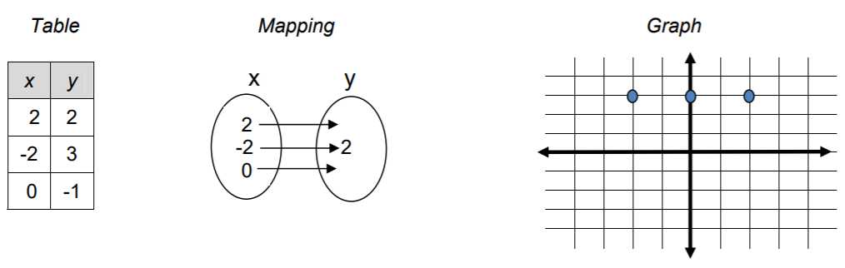
Functions Vs. Relations
{(0 , 1), (5 , -1), (3 , 1), (2 , 4)}

Slide 7
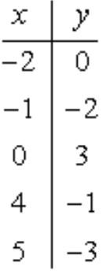
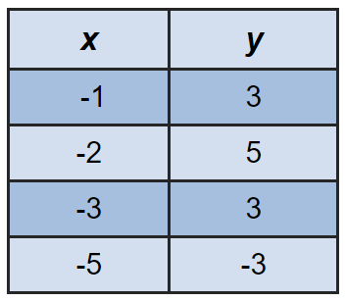
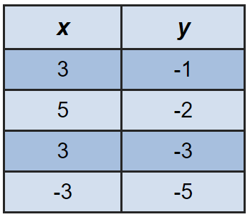
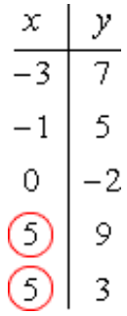
Not a Function
Table
Function
Circle the parts of each table that make it NOT a function

Slide 8
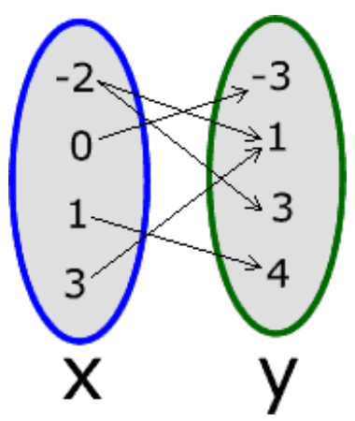
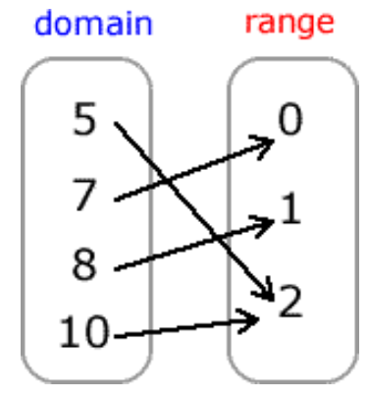
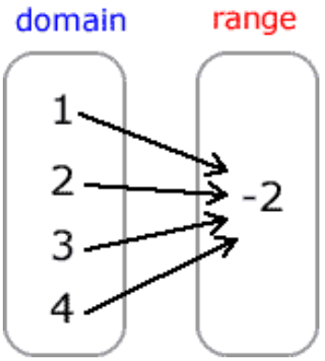
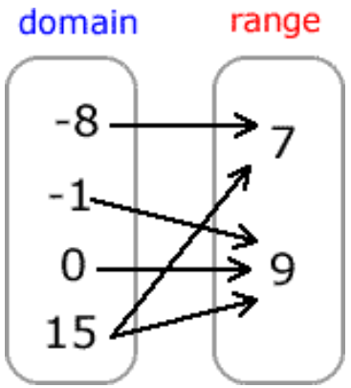
Not a Function
Mapping
Function
Circle the parts of each map that make it NOT a function

Slide 9


Not a Function
Coordinates
Function
(4, 2), (5, 1), (6, 0), (7, -1), (8, -2)
{(4, 2), (5, 1), (6, 0), (7, -1), (8, -2)}
Circle the parts of each set of coordinates that make them NOT a function

Slide 10
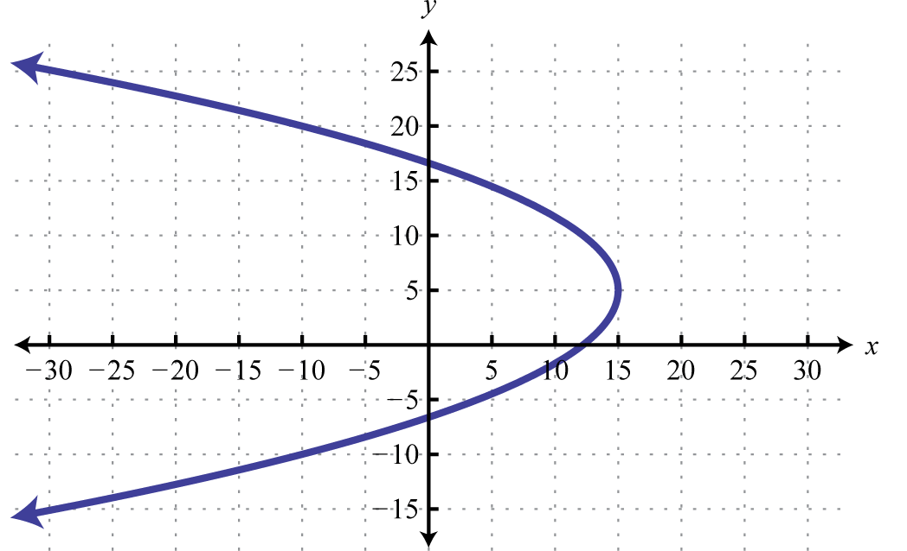
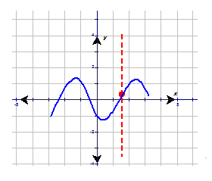
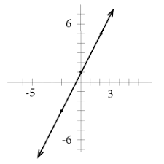
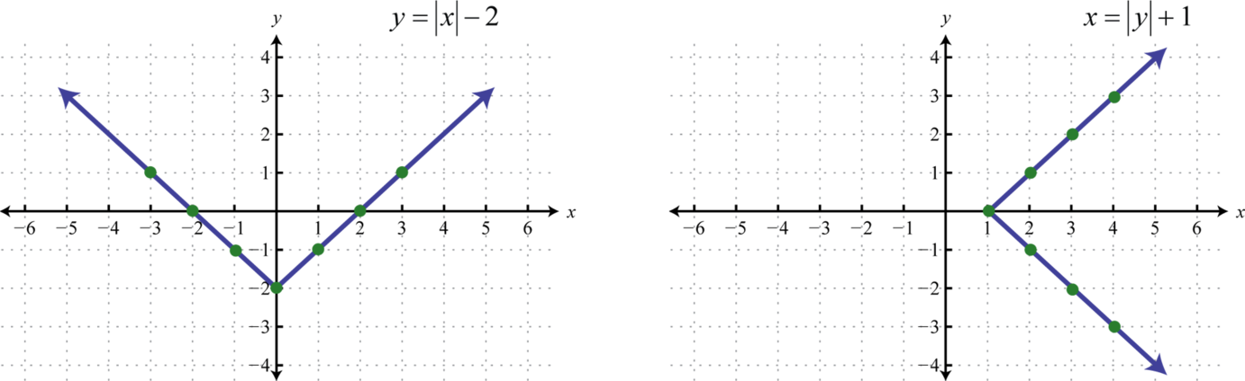
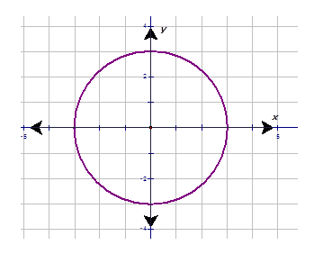
Not a Function
GRAPHS
Function
Use the vertical line test to prove each graph is a function
Circle 2 parts of each graph that make it NOT a function

Slide 11

Listing the Domain & Range of a Relation: Table
Domain | Range
x | y
1 | 5
3 | 15
6 | 30
9 | 45
11 | 55
Is this relation a function? YES or NO

Slide 12
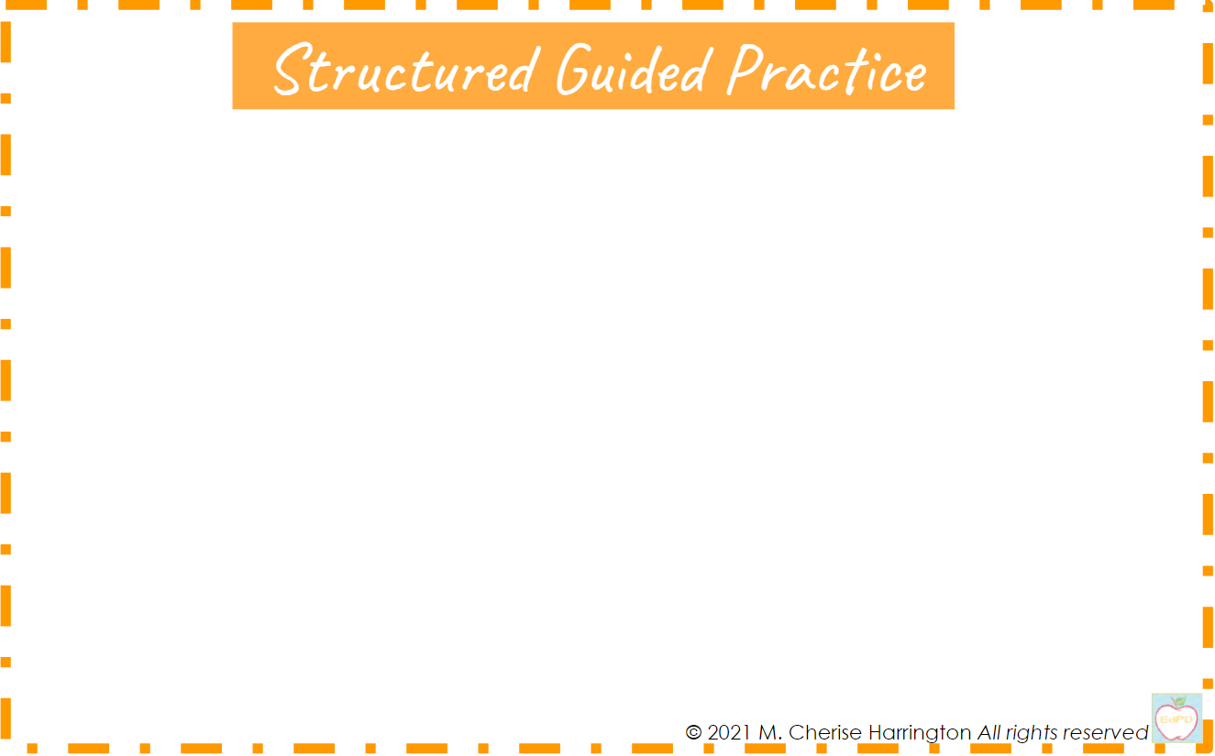
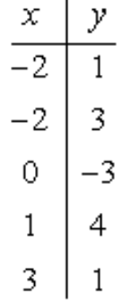
Listing the Domain & Range of a Relation: Table
Domain | Range
Is this relation a function? YES or NO

Slide 13
Listing the Domain & Range of a Relation: Set of Coordinates
Domain | Range
Is this relation a function? YES or NO

Slide 14


Tables, Equations & Slope Practice
1st Click on the IXL icon & sign-in, then click on the Titles to get the link
 | From Table to Equation

Slide 15
Identifying Functions Practice
1st Click on the IXL icon & sign-in, then click on the Titles to get the link
 | Identifying a Function from a Graph
Identifying Functions from Table, Coordinates and Graph | Identifying Functions from Mapping, Tables, Graphs & Coordinates

Slide 16


Function or Not Quiz

Slide 17
Content Objective: I will be able to define a function as a relation with exactly one input for every output.
Language Objective: I will be able to explain how to tell if a relation is a function in a table, set of coordinates and graph.

Slide 18


After completing the Independent Practice, drag the circle to the emoji that best describes how you feel about your understanding of this lesson, then, list what you learned and what you are still having trouble with.
(Use as much mathematical terminology as possible from the learning targets.)

